Slide 1
Building informative bot using amazon lex
Project by
1) raja n
2) Prasanna Venkatesh v

Slide 2
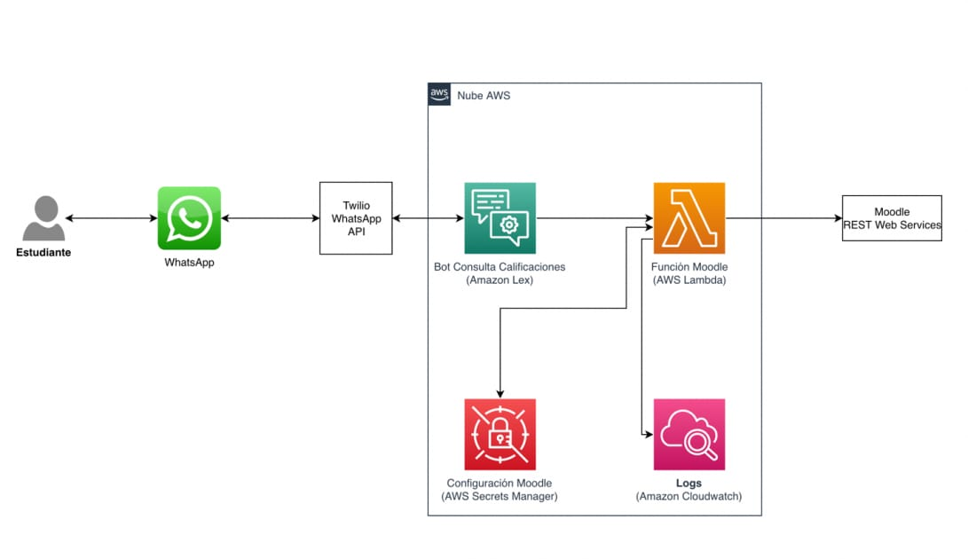
Architecture / message flow

Slide 3
Amazon lex Amazon Lex is a fully managed artificial intelligence (AI) service with advanced natural language models to design, build, test, and deploy conversational interfaces in applications. Steps involed
Create a bot and configure it with one or more intents that you want to support. Configure the bot so it understands the user's goal (intent), engages in conversation with the user to elicit information, and fulfill the user's intent.
Integrate the bot with lambda function to input event and response for the user.
Test the bot. You can use the test window client provided by the Amazon Lex console.
Publish a version and create an alias.
Deploy the bot. You can deploy the bot on platforms such as mobile applications or messaging platforms such as Facebook Messenger, Whatsapp, or integrate with 3rd party applications.
Use the bot effectively by providing the request and gain the response from the bot.
By collecting user feedback then upgrade the bot using user feedback.

Slide 4
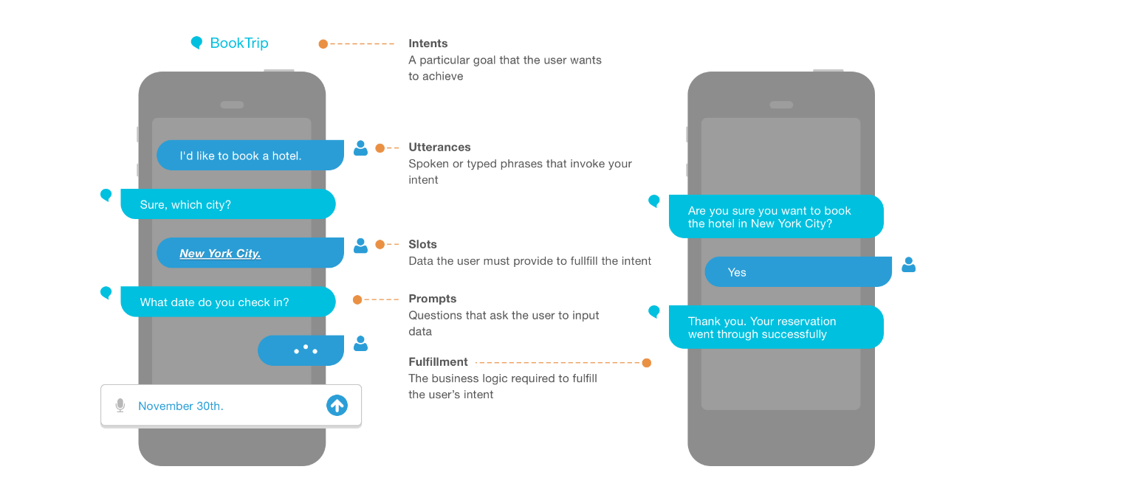
Keywords to be known

Slide 5
Application of amazon lex
Customer Support Chatbots
Virtual Assistants:
Education:
Hospitality
E-commerce:
Language Translation
Government Services

